Slide 1
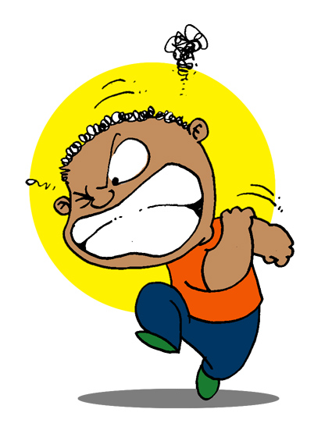


Anger
Learn all about anger and healthy ways to cope!
© 2017 Mylemarks LLC

Slide 2
What will we talk about today?
Definition of anger!
Anger Buttons!
Good vs. Poor ways to cope with anger!
Anger Rules!

Slide 3
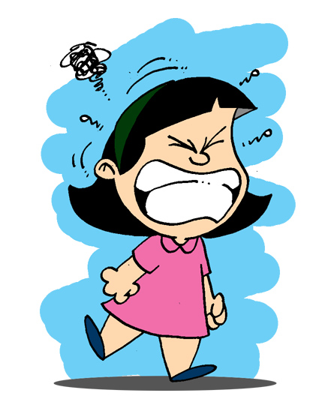
Anger Definition
What is anger?
Anger is the feeling you get when someone says or does something you don’t like - or if you don’t get your way.

Slide 4
Anger
Everyone gets angry!
Getting angry isn’t a bad thing. The important thing is that we learn how to deal with it in a healthy way so that it doesn’t hurt us or other people.

Slide 5

Anger Buttons
Before we learn about healthy ways to cope with anger, let’s talk about anger buttons!
Anger buttons are things that happen that make us feel angry.

Slide 6


Anger Buttons
Raise your hand if any of these examples are anger buttons for you!
  Someone takes your toy without asking
  Having to wait in a long line
  Getting a bad grade
  You’re not allowed to play outside
  Someone calls you a name
  Your friend breaks your toy on accident
  You get blamed for something you didn’t do
  A player on the other team is cheating
  You have to clean up the mess your sibling made
  You don’t make the team you tried out for
What are your top five anger buttons?

Slide 7
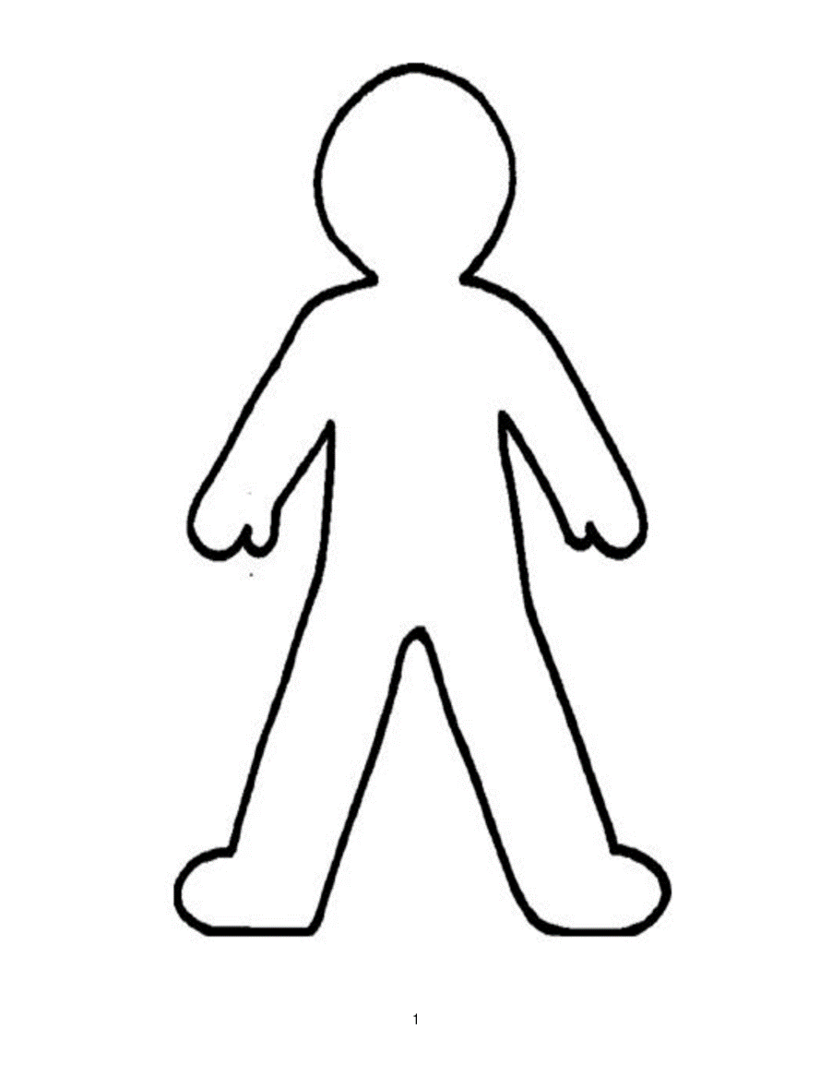

Anger and Our Bodies
When we get angry, our bodies have a reaction too!
What happens to your body when you start to get angry?
Headache
Tense shoulders
Face turns red
Breathing harder
Pounding heart
Clenched fists
Palms get sweaty
Knots in stomach
Need to pace/walk around

Slide 8
Coping with Anger
Coping with anger in a GOOD way means that you respond in a way that helps you and others feel better about the situation.
Coping with anger in a POOR way means that you respond in a way that ends up hurting you or other people.

Slide 9
Good Ways to Cope
  Stop and think! Before you respond, think about what might be the best way to handle the situation.
  Removing yourself from the situation. If you feel that you won’t be able to remain calm, you can take a break from the situation if you need.
  Telling the other person how they made you feel using an I-Feel Statement. Tell them why your feelings were hurt and what you need them to do differently next time.
  Talking to a friend or an adult about what made you angry. Sometimes it is helpful to hear from others about how they would handle the situation.
  Practicing relaxation to help your body calm down. Think of a peaceful place and imagine yourself being there while doing some deep breathing.

Slide 10
Good Ways to Cope
  Listening to music or watching a movie. Do this to help take your mind off of what is making you angry.
  Doing something physical. Let out some of your energy by playing a sport or a game that you enjoy.
  Keeping an Anger Journal. Every time you get angry, write down what made you angry and how you handled it. Go back and see if you can find any patterns about your anger.
  Doing something different. If the way you’ve been handling your anger keeps getting you in trouble, try to do something completely different just once and see how it goes!
  Can you think of any other Good ways to cope with anger?

Slide 11
Poor Ways to Cope
  Responding as soon as you get mad. Give yourself time to think about the best way to cope with your anger.
  Saying or doing mean things to the other person. This doesn’t help you feel better, and it just makes the other person angry.
  Having negative thoughts. Having negative thoughts about the person or the situation will only make things worse.
  Hitting the other person. It is NEVER okay to hit another person when you get angry!
  Holding it all in. When you get angry, it is always helpful to share your feelings with others rather than keeping them to yourself.
  Breaking things. It is NEVER okay to break things when you get angry!
  Can you think of any other Poor ways to cope with anger?

Slide 12
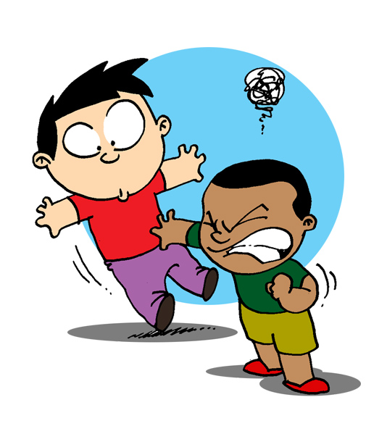
Examples
Read the example below and decide whether this person handled their anger in a Good or Poor way.
Richie and Tyler are playing basketball together at recess. Richie wins the game and says, “Whoo hoo! I won! I’m the best player in the world!”
This makes Tyler angry, so he pushes Richie down on the ground.
Why do you think Tyler was angry?
Would you have been mad in this situation too?
Do you think he handled it in a Good or Poor way? Why?
What might have been a better way for Tyler to handle his anger?

Slide 13
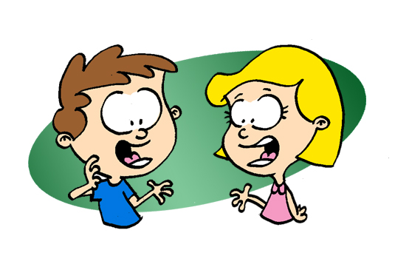
Examples
Read the example below and decide whether this person handled their anger in a Good or Poor way.
Zack hears that Linda is calling him names behind his back. This makes Zack very angry. When he gets to class, he asks Linda if they can talk. Zack tells Linda that it hurts his feelings whenever she makes fun of him. Linda ends up apologizing to Zack and promising never to do it again.
Why do you think Zack was angry?
Would you have been mad in this situation too?
Do you think he handled it in a Good or Poor way? Why?
What might have happened if he handled it in a poor way?

Slide 14
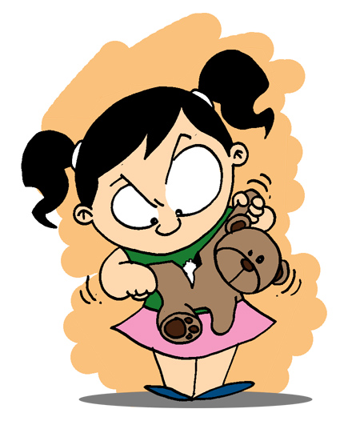
Examples
Read the example below and decide whether this person handled their anger in a Good or Poor way.
Ruth asks her sister if she can play with her toys. Her sister tells her, “No! I don’t want you getting your germs all over my stuff!” Ruth gets really mad. She waits until her sister goes outside to play, then she goes into her room and starts to destroy her toys.
Why do you think Ruth was angry?
Would you have been mad in this situation too?
Do you think she handled it in a Good or Poor way? Why?
What might have been a better way for Ruth to handle her anger?

Slide 15

Anger Rules
Remember, it is okay to get angry! It is all about how you handle it. Before deciding how to handle anger, remember these anger rules.
3
Don’t hurt yourself!
Don’t hurt others!
Don’t destroy property!

Slide 16
Activity!
Get together in groups and come up with a skit about anger, and present it for the class.
Make sure you show your characters handling their anger in a good way!

Slide 17
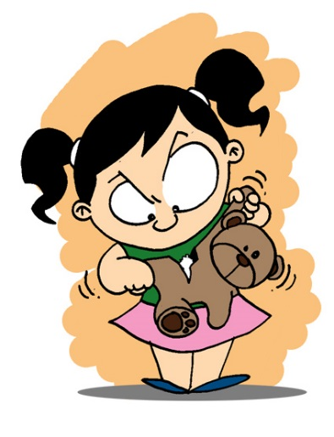
What did you
learn today?

Slide 18
The End ☺
© 2017 Mylemarks LLC

